Slide 1
Computer Organization 2025 Assignment II
Due Date: 23:59, May 14, 2025

Slide 2
Overview
The assignment includes five exercises.
The goal is to use the collected data to profile the program and compares the performance differences under different designs.
You will do the following steps to finish this assignment:
Write inline assembly code, run it on the RISC-V Spike simulator to get results.
Insert performance probes to collect the performance data in every exercise.
Complete the formulas of performance calculations.

Slide 3
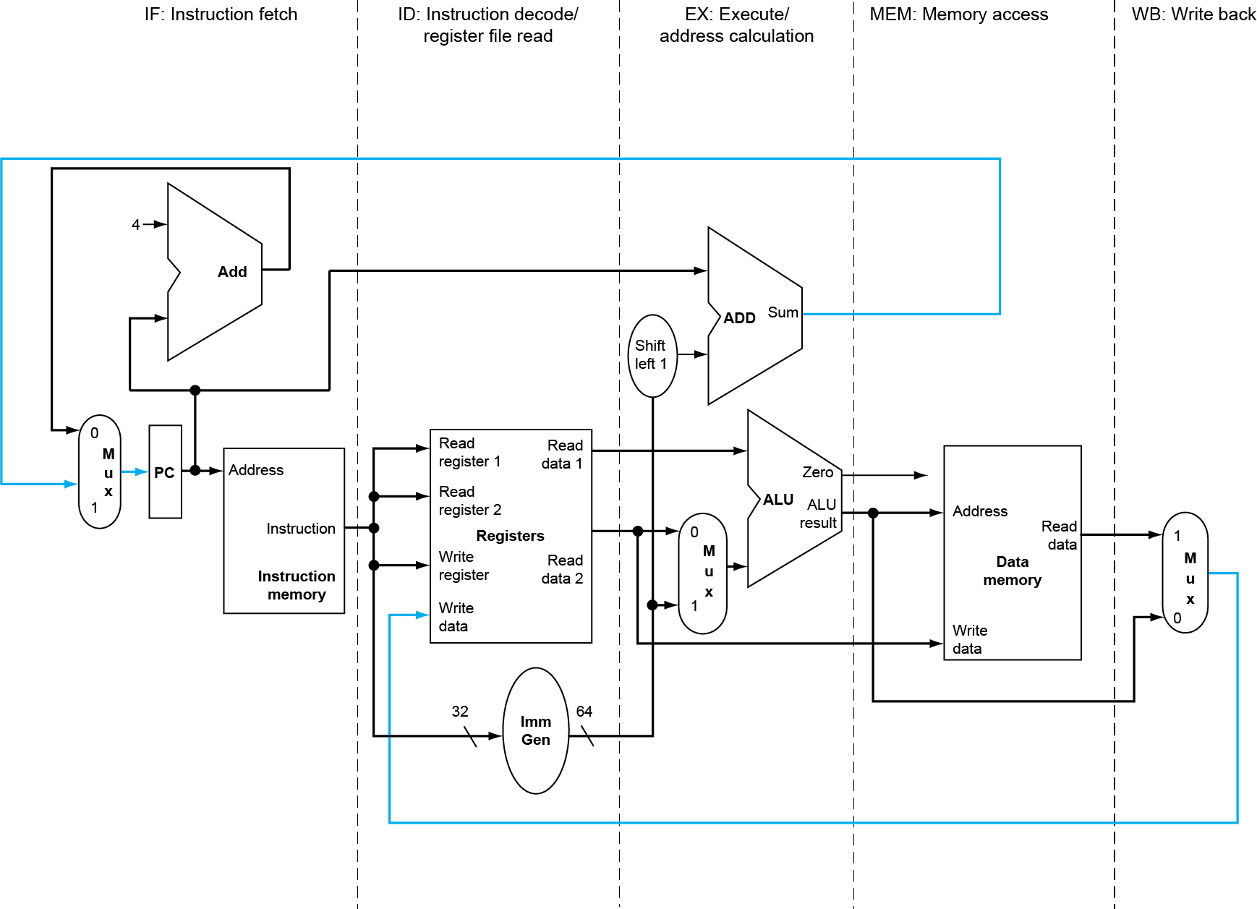
Performance Modeling
A five-stage processor

Slide 4
Performance Modeling (Cont’d)
There are several variables used to count the number of Integer, Memory access and Floating-point operations.
Uses fixed CPI numbers to summarize the delivered performance of RISC-V instructions executed on the target RISC-V processor.
The derived performance data should be stored in some variables, such as fft_cycle_count for the total cycle count calculated in the first exercise.
Variables | Definition
add_cnt | Used to count add{i}, vadd.vv… instructions
fadd_cnt | Used to count fadd.s, vfadd.vf, vfadd.vv instructions
dlw_cnt | Used to count fld instruction
Constants | Definition
add_CPI | CPI of instructions listed in add_cnt
fadd_CPI | CPI of instructions listed in fadd_cnt
dlw_CPI | CPI of instructions listed in dlw_cnt

Slide 5
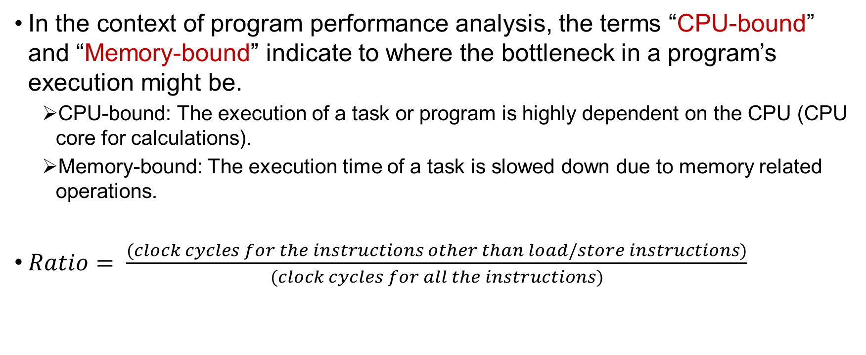
Performance Characterization
In the context of program performance analysis, the terms “CPU-bound” and “Memory-bound” indicate to where the bottleneck in a program’s execution might be.
CPU-bound: The execution of a task or program is highly dependent on the CPU (CPU core for calculations).
Memory-bound: The execution time of a task is slowed down due to memory related operations.
$Ratio= \frac{(clock cycles for the instructions other than load/store instructions)}{(clock cycles for all the instructions)}$

Slide 6
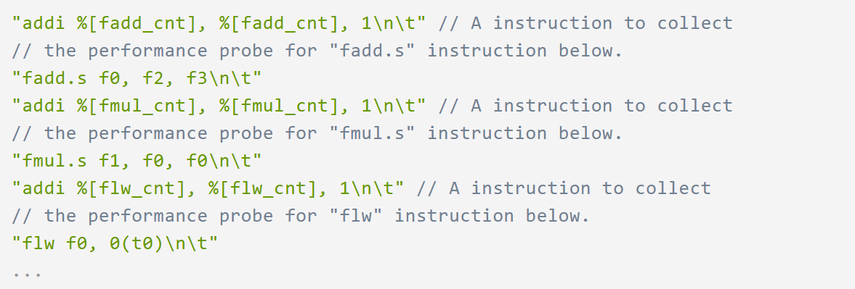
Performance Data Collection
It is done by the source-level code instrumentation, which means you have to insert the performance probes into your written assembly code.
You need to complete the formula of the total cycle count and the CPU execution time for every exercise.
You also need to complete the formula of the ratio of the time spent on CPU/Memory.

Slide 7
Assignment – 5 exercises
Exercise 1 (40%): Fast Fourier Transform (FFT) calculation and profile the execution performance.
Exercise 2-1 (18%): Single floating-point array multiplication without V extension and profile the execution performance.
Exercise 2-2 (22%): Single floating-point array multiplication with V extension and compare the performance with exercise 2-1.
Exercise 3-1 (16%): Single floating-point multiplication and profile the execution performance.
Exercise 3-2 (24%): Double floating-point multiplication and compare the performance with exercise 3-1.

Slide 8
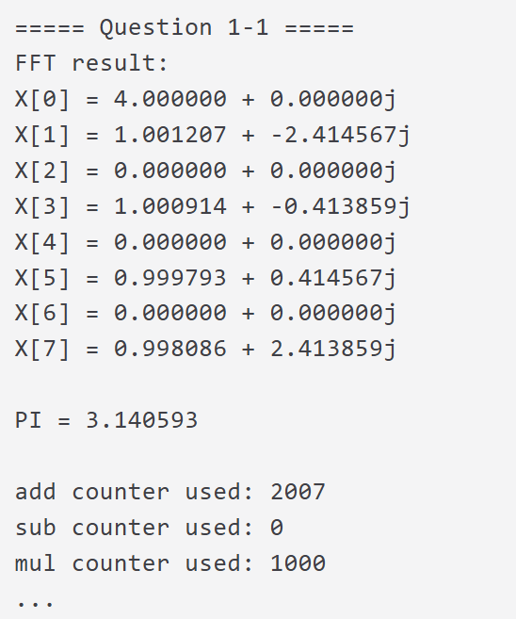
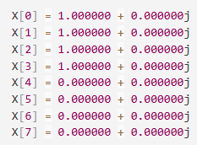
Exercise 1 (FFT Calculation, 40%)
Input: Takes input from the file fft_input.txt.
Each two numbers represent the real and imaginary parts of a complex element.
It must be eight pairs of single floating-point numbers between -10.0~10.0.
Output: The calculated result and performance data.
Calculates the total cycle count, the CPU time, and determine whether the program is CPU-bound or Memory-bound by instruction ratio.

Slide 9
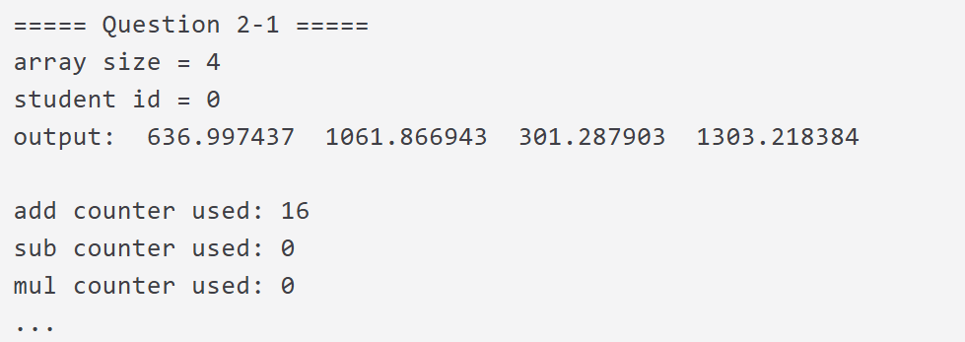
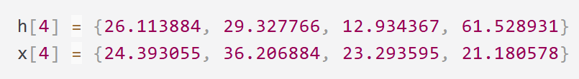
Exercise 2-1 (Array Multiplication without V extension, 18%)
Input: Reads two arrays with arr_size elements from the arraymul_input.txt.
Data Type: Single floating-point numbers between 0.0 and 100.0
Output: The calculated result and performance data.
Calculates the total cycle count, the CPU time.
Determine whether the program is CPU-bound or Memory-bound by instruction ratio.

Slide 10
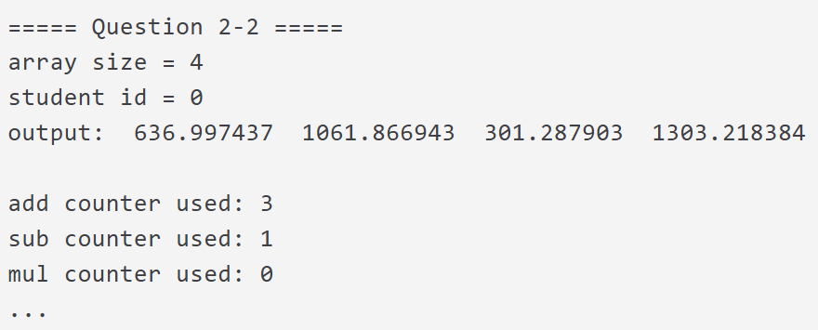
Exercise 2-2 (Array Multiplication with V extension, 22%)
Input: Reads two arrays with arr_size elements from the arraymul_input.txt.
Data Type: Single floating-point numbers between 0.0 and 100.0
Output: The calculated result and performance data.
Calculates the total cycle count, the CPU time.
Compared the speedup achieved by the vectorized version over the serial version (exercise 2-1), and the arr_size must be the same with exercise 2-1.

Slide 11
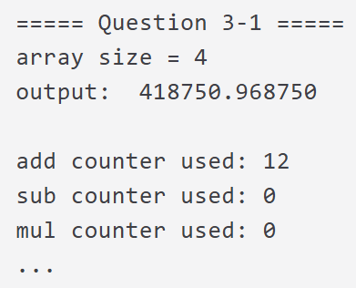
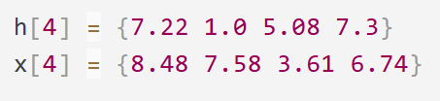
Exercise 3-1 (Single Floating-point Multiplication, 16%)
Input: Reads two arrays with arr_size elements from the arraymul_input2.txt.
Data Type: Single floating-point numbers between 0.0 and 10.0
Output: The calculated result and performance data.
Calculates the total cycle count, the CPU time.

Slide 12
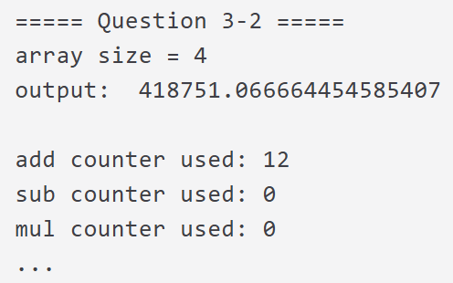
Exercise 3-2 (Double Floating-point Multiplication, 24%)
Input: Reads two arrays with arr_size elements from the arraymul_input2.txt.
Data Type: Double floating-point numbers between 0.0 and 10.0
Output: The calculated result and performance data.
Calculates the total cycle count, the CPU time.
Compared the slowdown and error caused by the double version over the float version, and the arr_size must be the same with exercise 3-1.

Slide 13
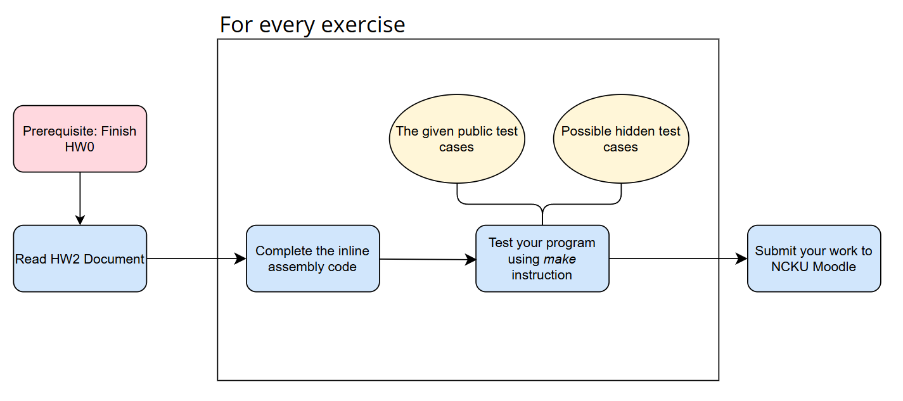
Suggested Workflow

Slide 14
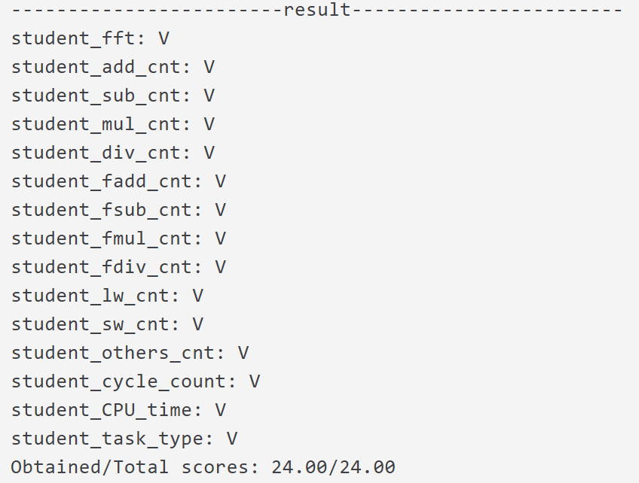
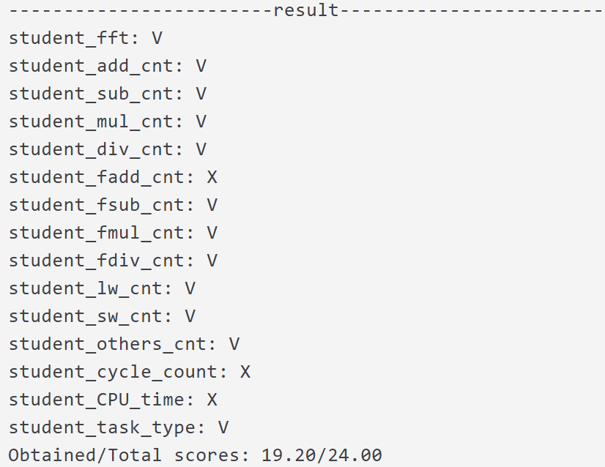
Test Your Assignment
Run “make test_exercise(number)” to test each exercise.
For example, enter make test_exercise1 in the terminal under the CO_StudentID_HW2 folder to test exercise 1.
Pass
Error

Slide 15
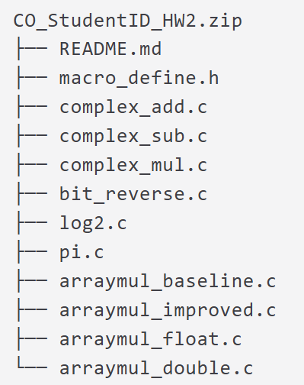
Submission of Your Assignment
Compress your source files into a zip file.
Submit your assignment to NCKU Moodle.
NOTE: Change all CO_StudentID to your student ID number, e.g., F12345678.zip.
The zip file should contain these files:

Slide 16
Scoring Criteria
Total: 120 points
Exercise 1: 1 public test cases (24 pts) + 2 hidden test cases (16 pts) → 40 pts
Exercise 2-1: 1 public (10.8 pts) + 2 hidden test cases (7.2 pts) → 18 pts
Exercise 2-2: 1 public (13.2 pts) + 2 hidden test cases (8.8 pts) → 22 pts
Exercise 3-1: 1 public (9.6 pts) + 2 hidden test cases (4.4 pts) → 16 pts
Exercise 3-2: 1 public (14.4 pts) + 2 hidden test cases (9.6 pts) → 24 pts
The public test cases account for 60% and the hidden test cases account for 40%.

Slide 17
Scoring Criteria – About README.md
README.md is mandatory.
Although it does not contribute to your score, failing to submit README.md will result in a score of zero for this assignment.

Slide 18
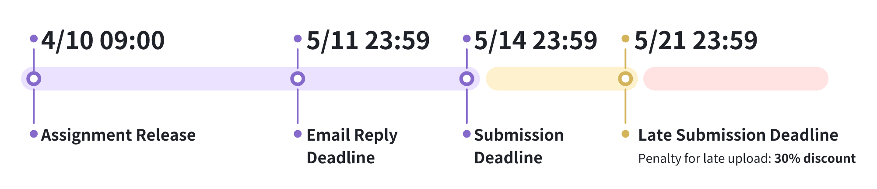
Important Note
Penalty for late upload
30% discount
Within seven days of the given deadline.
Incorrect format will lose 10 points.
A high similarity score between your code and someone else’s will result in a score of zero for this assignment.

Slide 19
Thank you for listening. The quiz will start at 9:50 AM.

